Slide 1
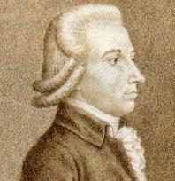
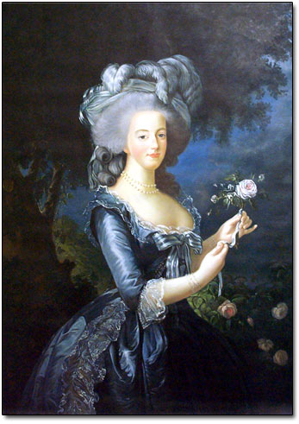
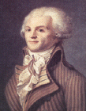
French Revolution
Abbe Sieyes, Lafayette, King Louis XVI, Marie Antoinette, Robespierre

Slide 2
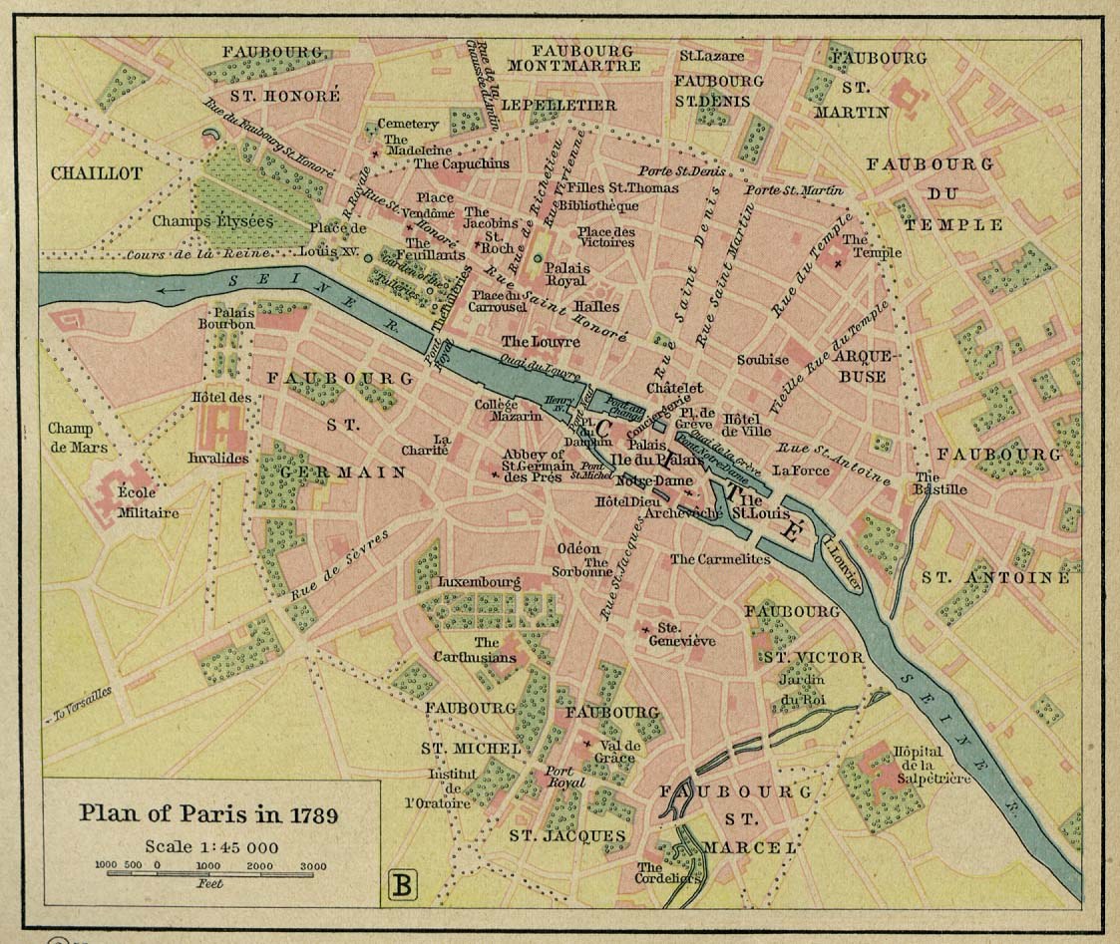

Slide 3
French Revolution (timeline cont.)
Convening of the Estates General (May 1789)—keep in mind Sieyes’s idea regarding the size and scope of the 3rd Estate
Tennis Court Oath (June 1789)—
King makes veto assertions
Growing violence
Formation of Permanent Committees to regulate affairs and replace Royal rule of day-to-day matters
**In general, uncertainty is norm and fears of royal use of military against citizens increases

Slide 4
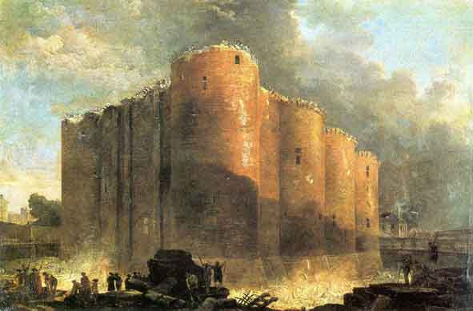
French Revolution (timeline cont.)
Storming of the Bastille (July 1789)
Parisians form militia, begin barricading city

Slide 5
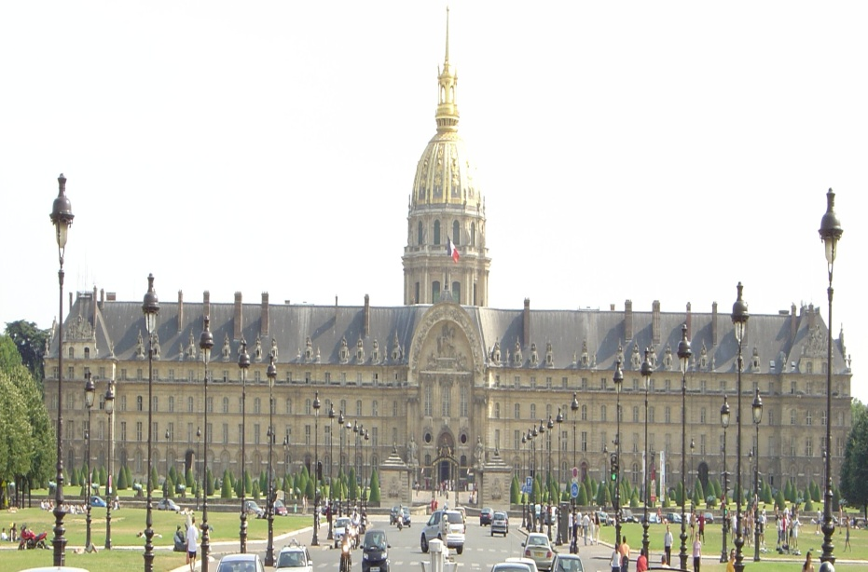
Storm Invalides for weapons, then on to the Bastille for gunpowder
Slaughter of soldiers, King told of “Revolution”
King withdraws troops from center of Paris

Slide 6
French Revolution (timeline cont.)
4th of August Decrees (1789)
Commune of Paris (formerly Permanent Committee) increases its authority
Uprisings continue across the country and in cities—sans culotte
Decrees renouncing feudalism, and push for passage of the Declaration of the Rights of Man

Slide 7
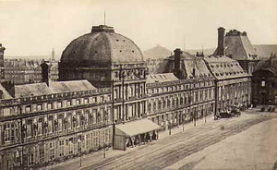
French Revolution (timeline cont.)
March of the Market Women (Oct. 5, 1789)
March on Versailles, calls for Lafayette to act
Lafayette leads National Guard to palace, meets with the King (and admits he cannot control all of his troops)
Takes King and Queen to Paris—installed at Tuileries—pseudo-house arrest
National Assembly reconvenes in Paris

Slide 8
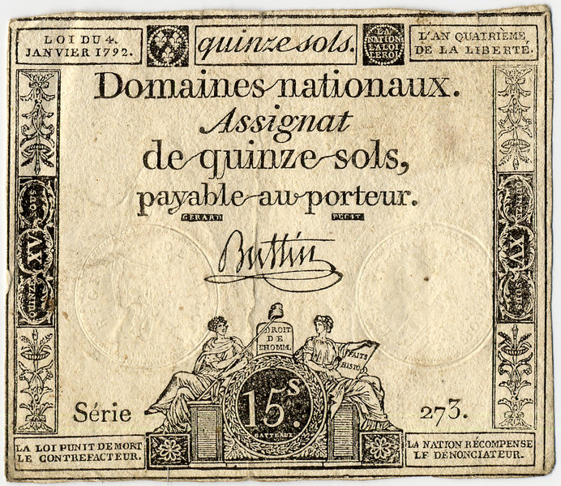
French Revolution (timeline cont.)
Decree on Church Lands (Nov. 1789)
Sale of lands, issuance of assignats
Means to keep country solvent, use paper as form of bond, evolved into currency
Problem of hyperinflation—led to Maximum Price Act of 1793

Slide 9
Civil Constitution of the Clergy (July 1790)
Church to be under purview of National Assembly
Clergy to renounce allegiance to any foreign power (e.g., Pope)
Civil Constitution causes serious uproar, opposition to action increases

Slide 10
French Revolution (timeline cont.)
King has reluctantly signed these major provisions into law.
However, many nobles (including the King’s brothers—Comte d’Artois and Comte de Provence) believe the King is coerced, so laws are not valid

Slide 11
French Revolution (timeline cont.)
King is facing pressure from within and from without—concerns over foreign powers taking advantage of instability in France, issue of Marie Antoinette’s fidelity to the French people
The Queen was sister to the Emperor of Austria, and daughter to rulers of Holy Roman Empire

Slide 12
French Revolution (timeline cont.)
Encyclical Charitas (April 1791)
Pope Pious VI calls on clergy to repudiate vows to National Assembly under Civil Constitution
Suspends those that have taken oath

Slide 13
French Revolution (timeline cont.)
Comte de’Artois and Comte de Provence have formed resistance to Revolution, and Artois has formed an émigré army
Other monarchies taking note

Slide 14
French Revolution (timeline cont.)
King and Queen make a couple of attempts to leave Tuileries, first to St. Cloud (April 1791) and then to Varennes (June 1791)
There was confusion amongst the populace as to whether or not the king fled or he was abducted
Both attempts were frustrated, Lafayette brought King back to Tuileries
The attempts are made all the more significant given the movements and positioning of military within France and on its borders—e.g., Austria (where King Leopold II reigned—the queen’s brother)

Slide 15
French Revolution
Major groups within the National Assembly
Jacobins
Feulliant
Clergy
Nobility
Indeterminates

Slide 16
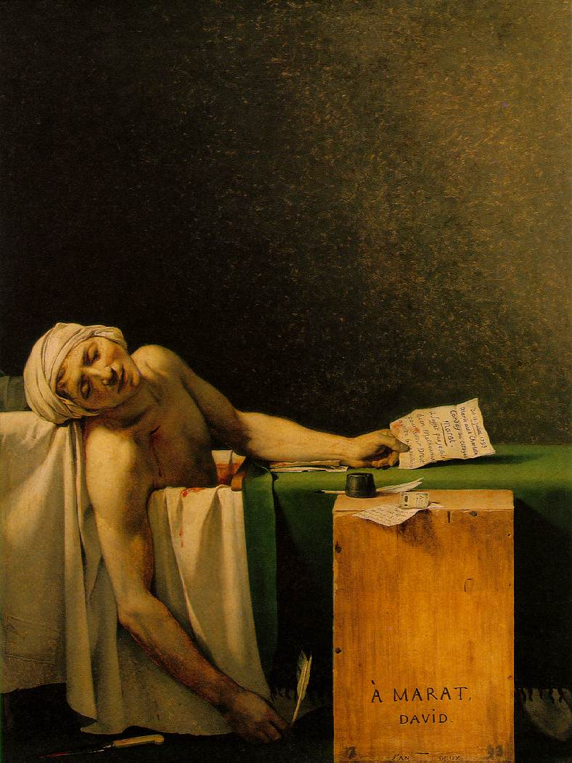
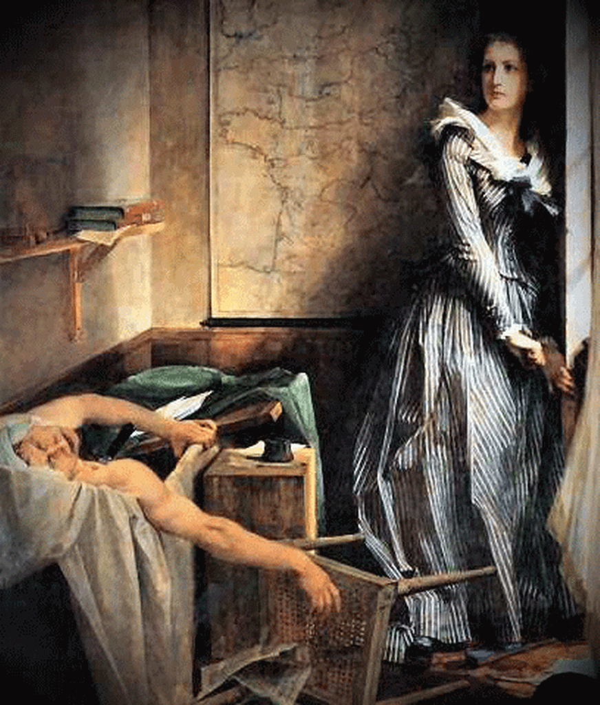
French Revolution
Newspapers served as organs for various factions and their views—most virulent was that of Jean-Paul Marat in the Ami du peuple (Friend of the People)
Newspapers added to the discussions of the Assembly, reported actions of the Assembly, became part of the intellectual, political background of the Revolution
For his troubles he fell to the knife of a female assassin (who blamed him for much of the bloodshed of the Revolution)

Slide 17
French Revolution
Newspapers served as a medium of discussion, accusation, etc.
Some were downright scurrilous

